Slide 1

Computational Methods for the Interaction of Light and Matter
G. Kanschat
IWR, Uni Heidelberg
&
C.P. Dullemond
ZAH, Uni Heidelberg

Slide 2
Where does radiation interact with matter?

Slide 3
Where does radiation interact with matter?

Slide 4
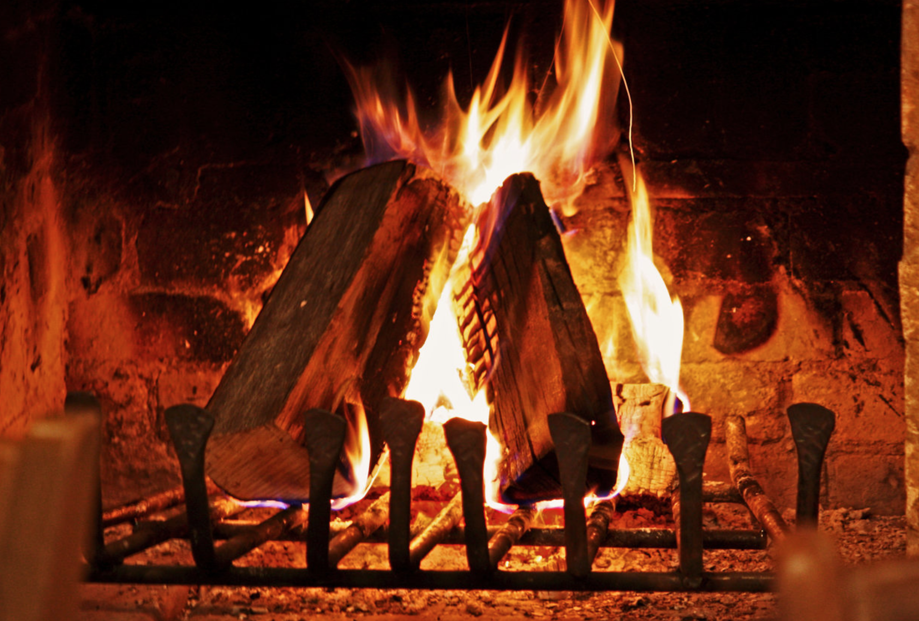
Where does radiation interact with matter?

Slide 5
Where does radiation interact with matter?

Slide 6
Where does radiation interact with matter?

Slide 7
Where does radiation interact with matter?

Slide 8
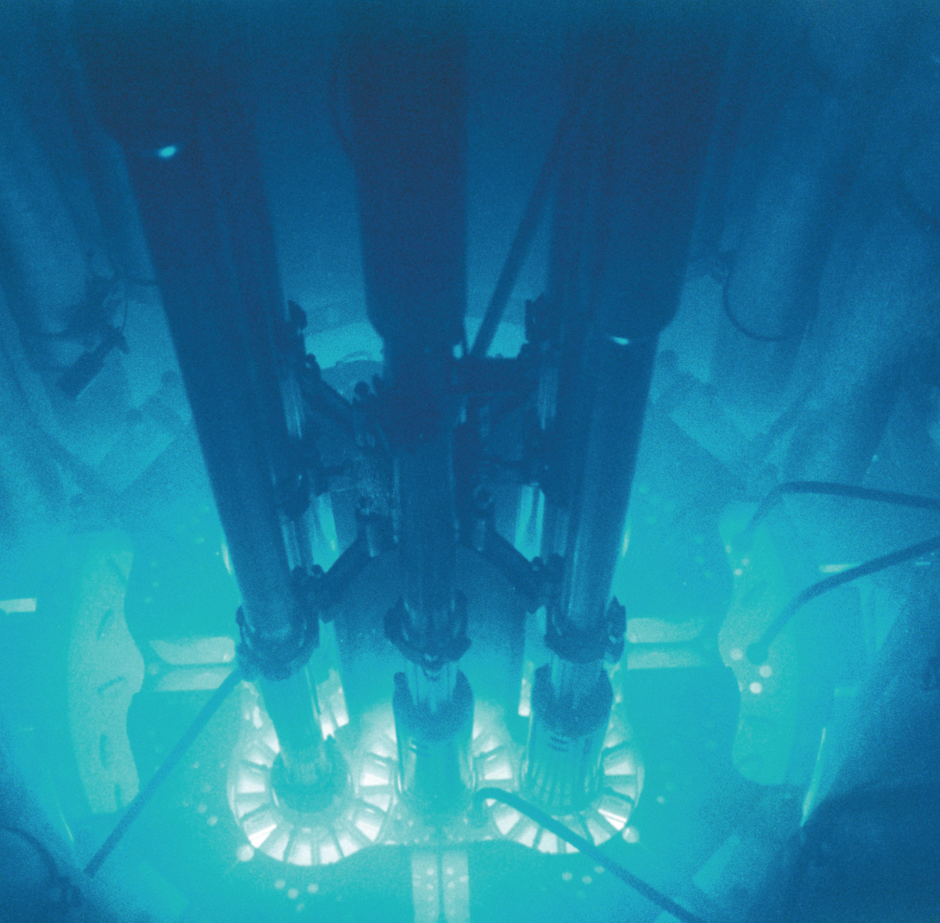
Where does radiation interact with matter?

Slide 9
Concept
Theory of radiative transfer and the interaction of radiation and matter
Numerical methods for solving this problem under various conditions
Applications

Slide 10
Concept
Theory of radiative transfer and the interaction of radiation and matter
Formal Transfer Equation
Scattering and absorption/emission by solid particles ("continuum transfer")
Quantum transitions in gaseous media ("line transfer")
The difficulty of Radiative Transfer: Non-local interaction
Mathematical formalisms

Slide 11
Concept
Numerical methods for solving this problem under various conditions:
Monte Carlo
Moment methods
Lambda Iteration
Short characteristics
Finite Volume, Discontinuous Galerkin schemes
Here is where YOU come in:
Bring your own laptop, with Python (with standard libs: numpy, matplotlib), C compiler, Fortran compiler
You will program your own mini-versions of these algorithms.
And you will learn to use the big codes, too.

Slide 12
Concept
Applications:
Astrophysical objects
Atmospheres of planets

Slide 13
Requirements:
Have some experience with programming and plotting of data
Basic mathematics, basic physics, though we will recap most of it.

Slide 14
Weekly schedule
Wednesdays: 2 hours from 11:15-13:00
INF 205 / SR C
Fridays: 1 hour from 12:15-13:00
INF 205 / SR B (different room!) Check...
(Discussion on time)

Slide 15
Examination
Oral exam or project
Credit points (if exercises done): 6

Slide 16
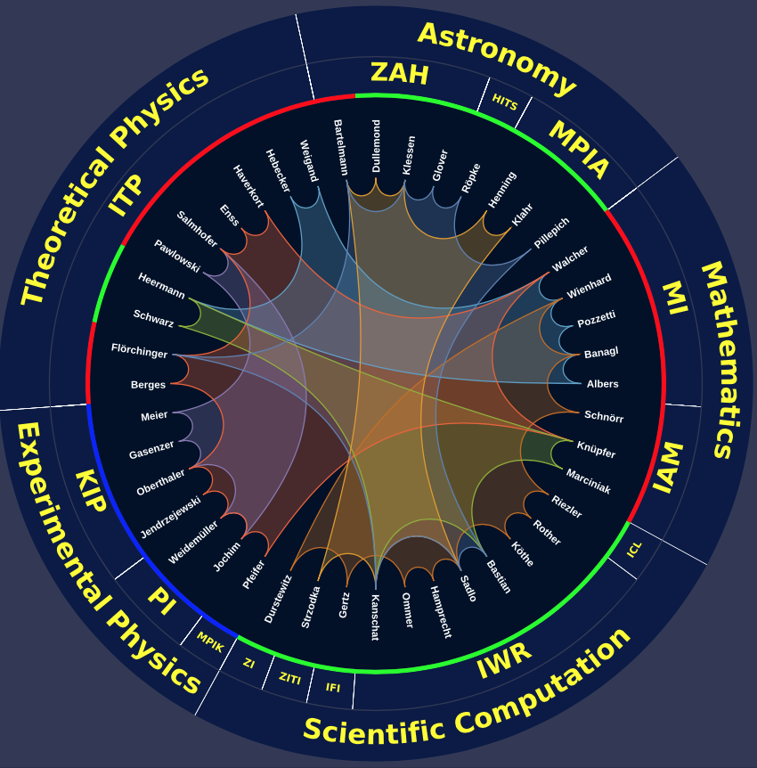
Excellence Cluster STRUCTURES

Slide 17
Questions?

Slide 18
How to describe light

Slide 19
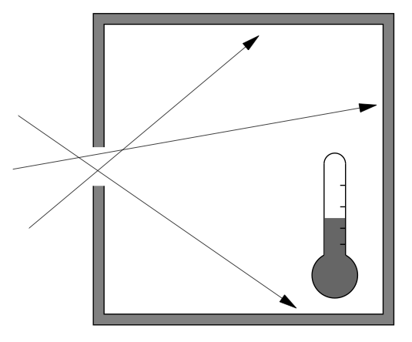
Measuring radiation
CAREFUL: Just a thought experiment
Radiation flux:
Energy increase per unit
surface and time
Important: Must start
with very cold cavity.

Slide 20

Measuring radiation
The increase of temperature per unit of time is an indication of how much radiation passes through the pupil.
The conversion factor between dT/dt into Flux depends on the details of the instrument.
CAREFUL: Just a thought experiment
Temperature
Time

Slide 21
Measuring radiation
You have to start with a very cold cavity, otherwise the temperature starts to saturate.
The cavity will start to radiate itself, and eventually as much radiation escapes through the pupil as enters through it. We then reach saturation.
This is a fundamental physical effect! Cannot be avoided.

Slide 22
Measuring radiation
The saturation temperature is exactly defined by physics:
Saturation temperature
Temperature
(Stefan-Boltzmann
Konstante)
Time

Slide 23
Blackbody radiation
Apparently the walls of the cavity produce a well-defined radiation field:
When you look through the pupil you see exactly the following flux:
This follows direction from quantum thermodynamics
The perfect cavity is called a "blackbody", and the radiation field emerging from it "blackbody radiation".

Slide 24
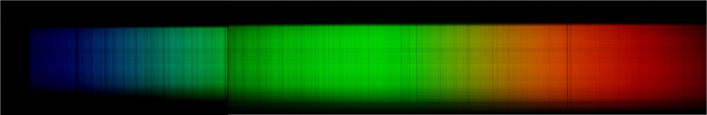
Wavelength, frequency
Frequeny ν [Hz]
Wavelength λ [cm]

Slide 25
Spectrum: Flux per unit wavelength
λ [cm]
dλ [cm]

Slide 26
Spectrum: Flux per unit wavelength
dν [Hz]
ν [Hz]

Slide 27
One can use both, but be careful...
dν [Hz]
ν [Hz]
λ [cm]
dλ [cm]
aber

Slide 28
Spectrum of a blackbody
Planck-Function
Planck constant
Boltzmann constant

Slide 29
Spectrum of a blackbody

Slide 30
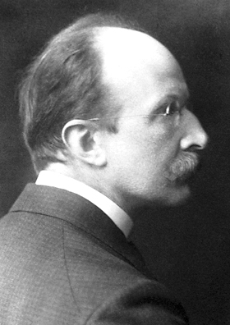
Spectrum of a blackbody
One photon has 2 degrees of freedom
Density of quantum states
Photon energy
Occupation number (Quantum-Statistics)
This only works if one considers radiation as consisting of quantized
energy units. Max Planck discovered this in 1900 when he (as an act
of desperation) tried to describe blackbody radiation with Boltzmann
statistics, even though initially he did not seriously believe in light
quanta! Without realizing it, he started the revolution of quantum
mechanics.

Slide 31
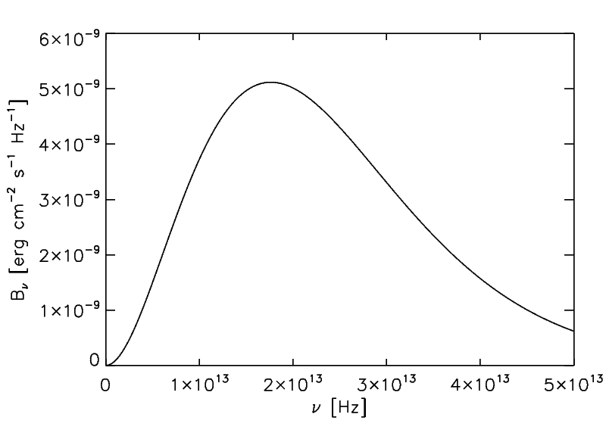
Spectrum of a blackbody
T = 300 K

Slide 32
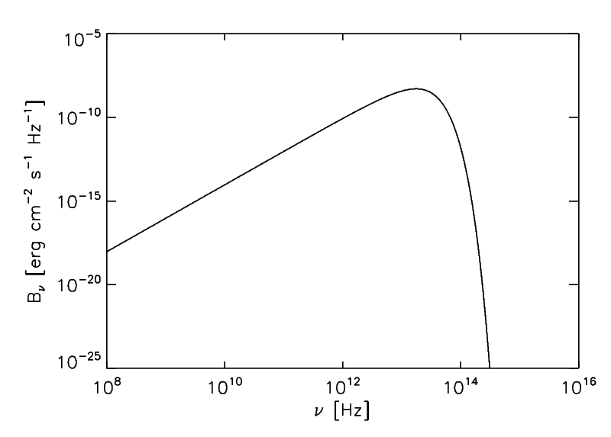
Spectrum of a blackbody
T = 300 K
Log-Log Plot:
Much better!

Slide 33
Spectrum of a blackbody
Rayleigh-Jeans Limit
Proof:

Slide 34
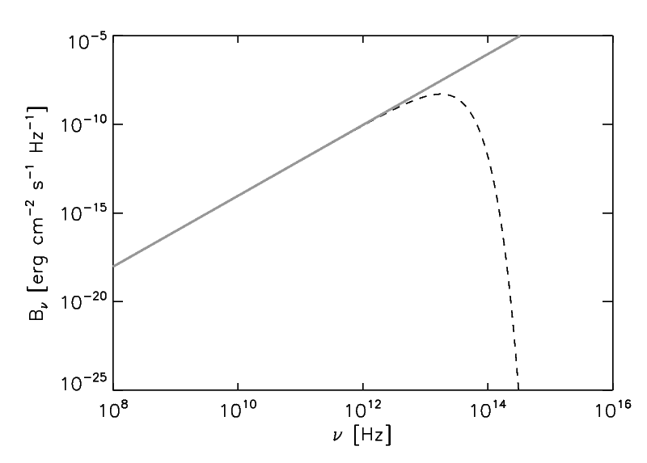
Spectrum of a blackbody
Rayleigh-Jeans Limit
At low frequencies the Rayleigh-Jeans law works very well.
T = 300 K
At high frequencies we must apply the quantum nature of light, otherwise we get the "ultraviolet catastrophe".

Slide 35
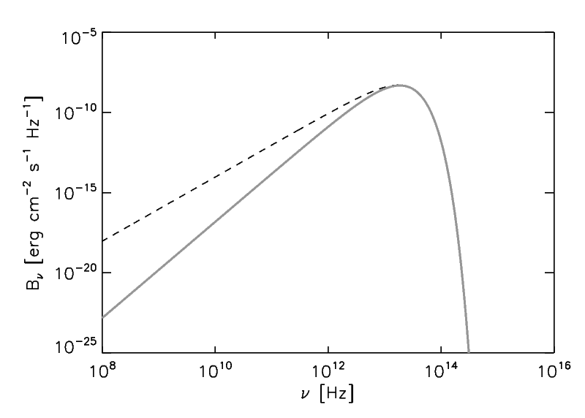
Spectrum of a blackbody
Wien Limit
But photons are "bosons", and thus do not obey the Pauli exclusion principle. So one can have many photons occupying the same quantum state.
T = 300 K
At high frequencies the Wien law is obeyed.
This would be the case if each
quantum state could only be
occupied by a single photon.

Slide 36
Spectrum of a blackbody
T = 300 K
Rayleigh-Jeans-
regime
Wien-
regime
Quantum states
are under-
occupied (i.e.
in general <<1
photon / state)
Quantum states are
multiply occupied

Slide 37
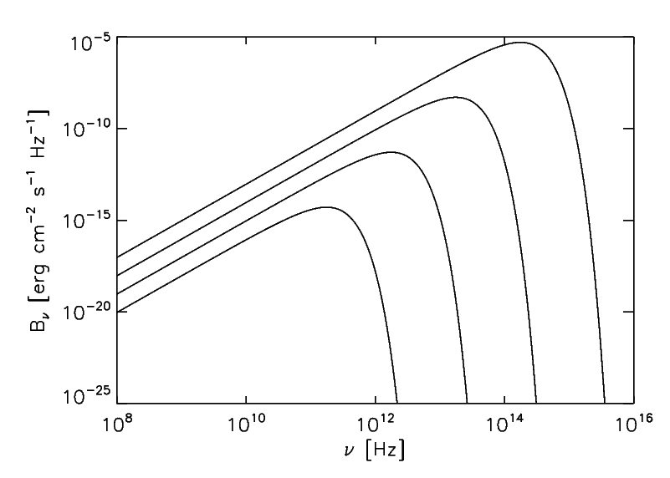
Spectrum of a blackbody
(Wien displacement law)
T = 3000 K
T = 300 K
T = 30 K
T = 3 K

Slide 38
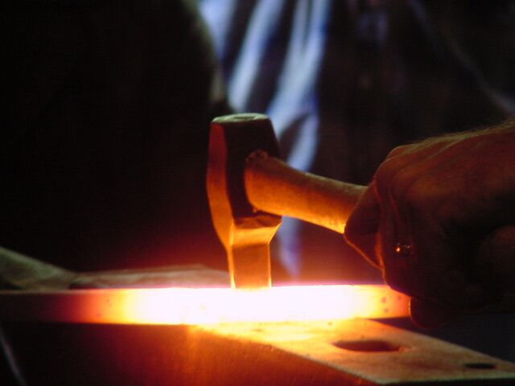
Urheber: Unbekannt. Quelle: http://www.volunteerlocal.com/blog/tag/strike-while-the-iron-is-hot/

Slide 39
Flux from a blackbody
The integral of the flux over all frequencies (wavelengths) gives the
total (=bolometric) flux:
Temperature:
T

Slide 40
Star as a blackbody
To first order we can describe a star as a blackbody radiator
d
R*
Flux at the surface:
Luminosity:
Observed flux:

Slide 41
Star as a blackbody
To first order we can describe a star as a blackbody radiator
d
R*
Flux at the surface:
Luminosity:
Observed flux:

Slide 42
Radiation is more than just flux:
Introducing the
"intensity"
(="radiance")

Slide 43
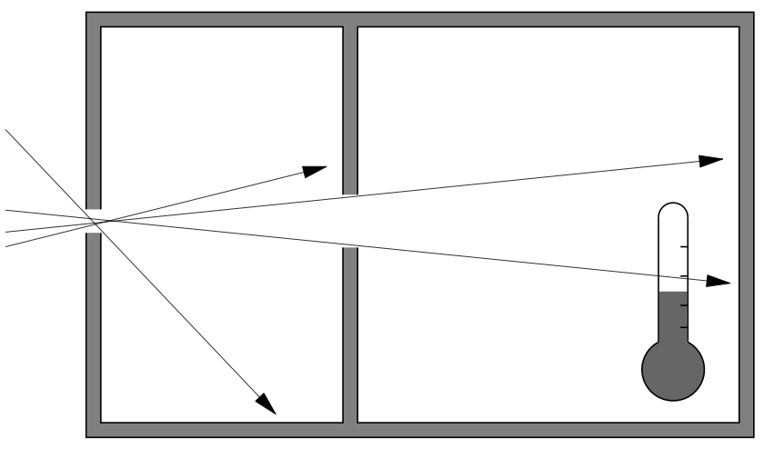
Directional information in radiation
„Intensity“ I_{ν}
Dimension (CGS units):
Warning: just schematic. Real instruments
work differently!
Depends on position, frequency and direction:
In vacuum, where radiation can move freely, we have:

Slide 44
Directional information in radiation
Intensity in direction
is constant along a ray
that goes in direction
(only true in vacuum!!)
s=10
s=0

Slide 45
Directional information in radiation
Intensity in direction
is constant along a ray
that goes in direction
(only true in vacuum!!)
s=10
s=0

Slide 46
Directional information in radiation
Intensity in direction
is constant along a ray
that goes in direction
(only true in vacuum!!)
s=10
The image gets bigger on the rhetina,
but it does not shine more brightly.
So indeed, intensity is constant!
s=0

Slide 47
Flux versus intensity of a star
Why does the measured flux of a star go as d⁻² while the
intensity remains constant with d?
and for d>>R* we also have:
A
B

Slide 48
Optical depth (optically thick/thin)
The „optical depth“ of an object along a ray is
„how many mean free paths units are there along the ray?“
s₁
An optically thick medium
is a medium that has a
high optical depth.
is the opacity
s₀
Mean free path:

Slide 49
Eddington-Barbier Rule
A rough estimate of the observed Intensity I_{ν} of an object/cloud is:
τ_{ν}=2/3
In other words: You see that, which lies around optical depth of 2/3.

Slide 50
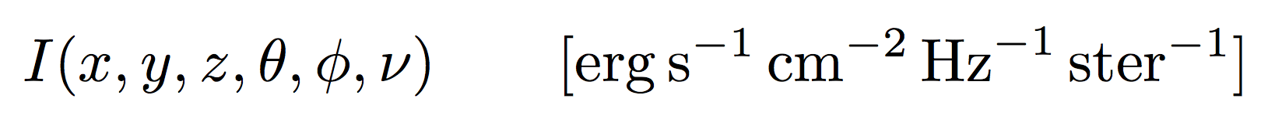
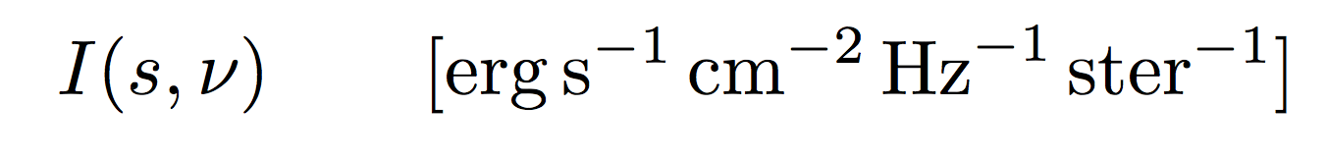
Radiative transfer: A short review
Radiative Transfer is a 7-dimensional problem
(that's one of the reasons it is so hard and expensive to solve):
Usually: semi-steady-state:
If the emission and extinction coefficients are known, you can
reduce this to the Formal Transfer Equation along a single ray:

Slide 51
Radiative transfer: A short review
Formal Transfer Equation along a ray:
Over length scales larger than 1/ρκ_{ν} intensity I tends to approach source function S.
Photon mean free path:
Optical depth of a cloud of size L:
In case of local thermodynamic equilibrium: S is Planck function:
Kirchhoff's law

Slide 52
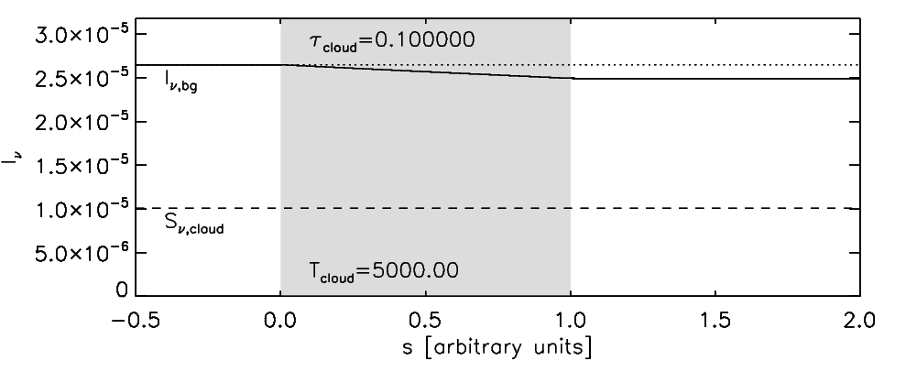
Rad. trans. through a cloud of fixed T
T_{cloud}
I_{ν,bg}
τ_{cloud}
I_{ν,out}
T_{bg}=6000 K

Slide 53
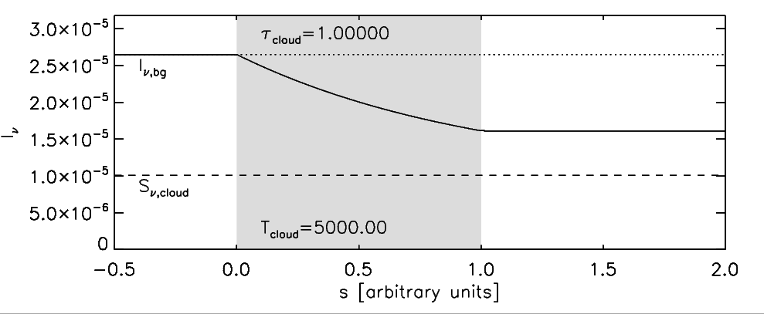
Rad. trans. through a cloud of fixed T
T_{cloud}
I_{ν,bg}
τ_{cloud}
I_{ν,out}
T_{bg}=6000 K

Slide 54
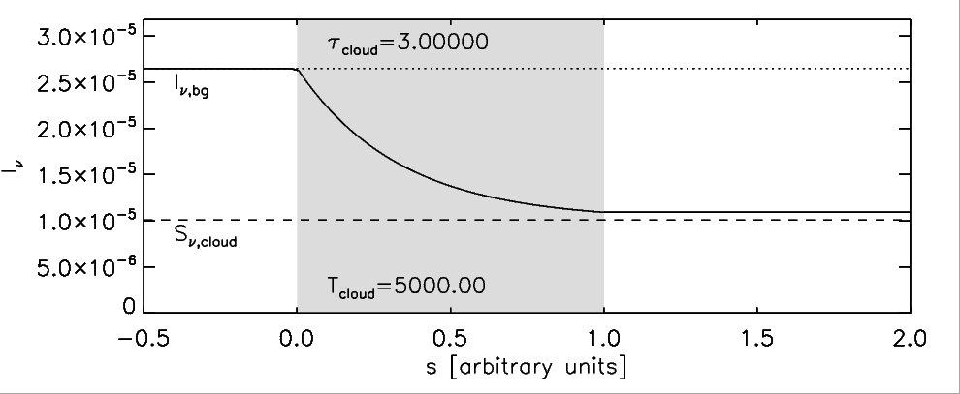
Rad. trans. through a cloud of fixed T
T_{cloud}
I_{ν,bg}
τ_{cloud}
I_{ν,out}
T_{bg}=6000 K

Slide 55
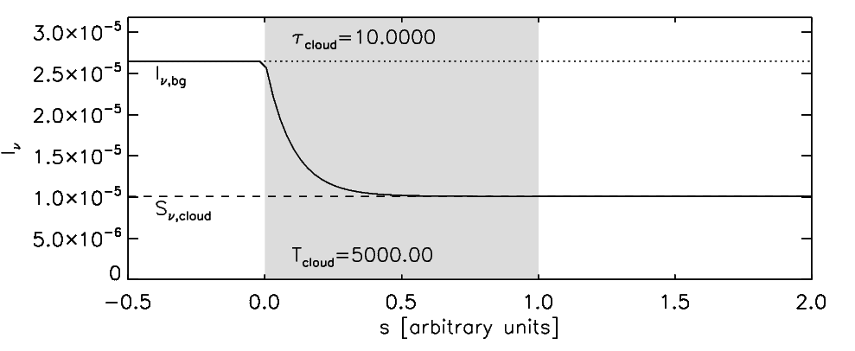
Rad. trans. through a cloud of fixed T
T_{cloud}
I_{ν,bg}
τ_{cloud}
I_{ν,out}
T_{bg}=6000 K

Slide 56
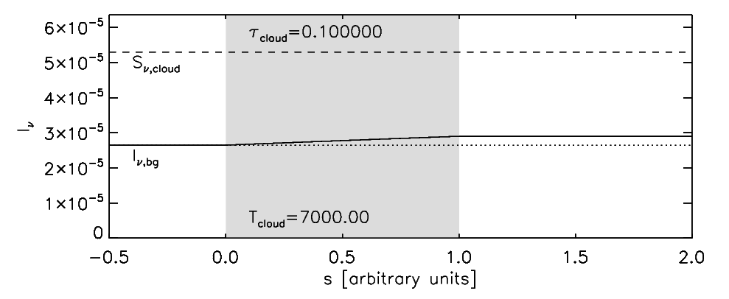
Rad. trans. through a cloud of fixed T
T_{cloud}
I_{ν,bg}
τ_{cloud}
I_{ν,out}
T_{bg}=6000 K

Slide 57
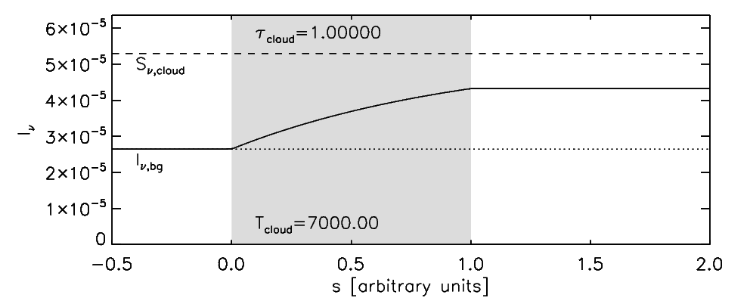
Rad. trans. through a cloud of fixed T
T_{cloud}
I_{ν,bg}
τ_{cloud}
I_{ν,out}
T_{bg}=6000 K

Slide 58
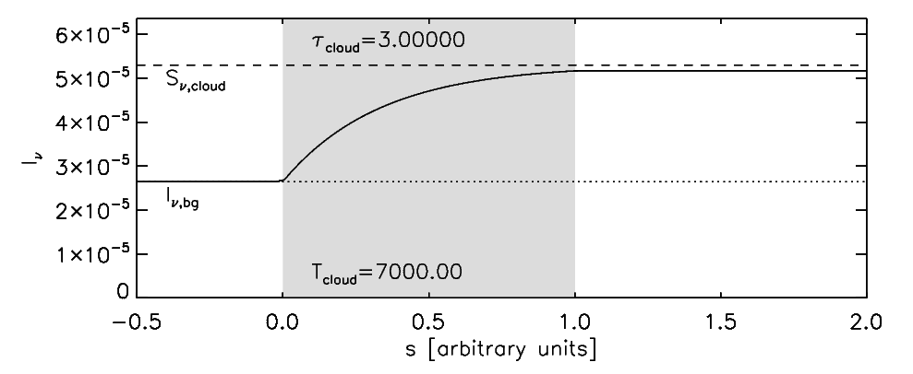
Rad. trans. through a cloud of fixed T
T_{cloud}
I_{ν,bg}
τ_{cloud}
I_{ν,out}
T_{bg}=6000 K

Slide 59
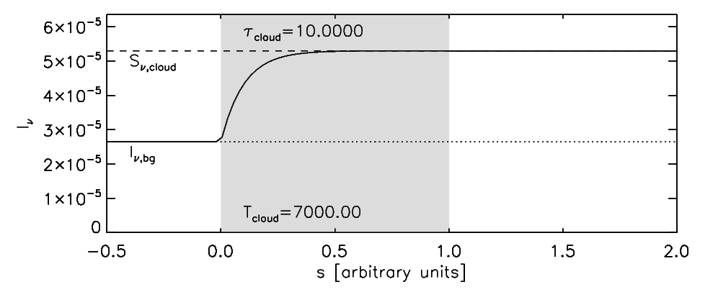
Rad. trans. through a cloud of fixed T
T_{cloud}
I_{ν,bg}
τ_{cloud}
I_{ν,out}
T_{bg}=6000 K

Slide 60
Formal radiative transfer solution
Radiative transfer equation again:
Observed flux from single-temperature slab:
for
and

